Slide 1
ELECTRIC FLUX DENSITY, GAUSS’S LAW AND DIVERGENCE

Slide 2
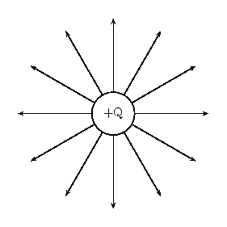
Electric flux is a system of lines about the same point charge which streams away systematically from that point charge.

Slide 3
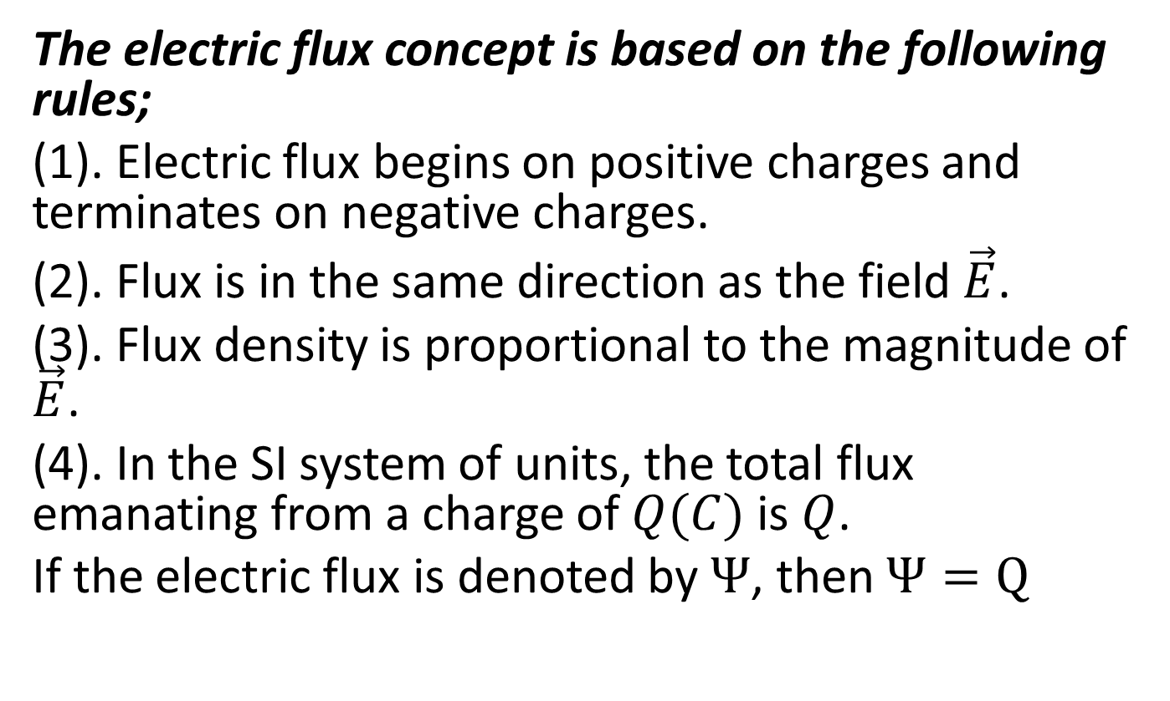
The electric flux concept is based on the following rules;
(1). Electric flux begins on positive charges and terminates on negative charges.
(2). Flux is in the same direction as the field $\vec{E}$.
(3). Flux density is proportional to the magnitude of $\vec{E}$.
(4). In the SI system of units, the total flux emanating from a charge of $Q(C)$ is $Q$.
If the electric flux is denoted by $Ψ$, then $Ψ=Q$

Slide 4
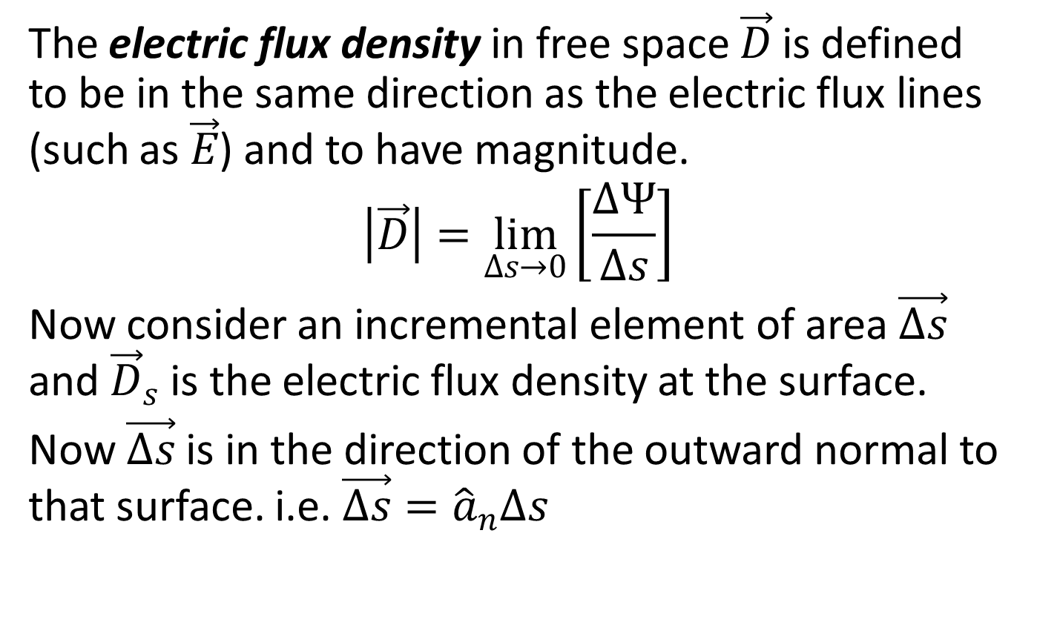
Gauss’s law (Electric Flux Density)
The electric flux density in free space $\vec{D}$ is defined to be in the same direction as the electric flux lines (such as $\vec{E}$) and to have magnitude.
$$\left|\vec{D}\right|=\lim_{∆s→0}\left[\frac{∆Ψ}{∆s}\right]$$
Now consider an incremental element of area $\vec{∆s}$ and ${\vec{D}}_{s}$ is the electric flux density at the surface.
Now $\vec{∆s}$ is in the direction of the outward normal to that surface. i.e. $\vec{∆s}={\hat{a}}_{n}∆s$

Slide 5
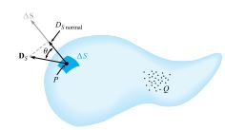

Slide 6
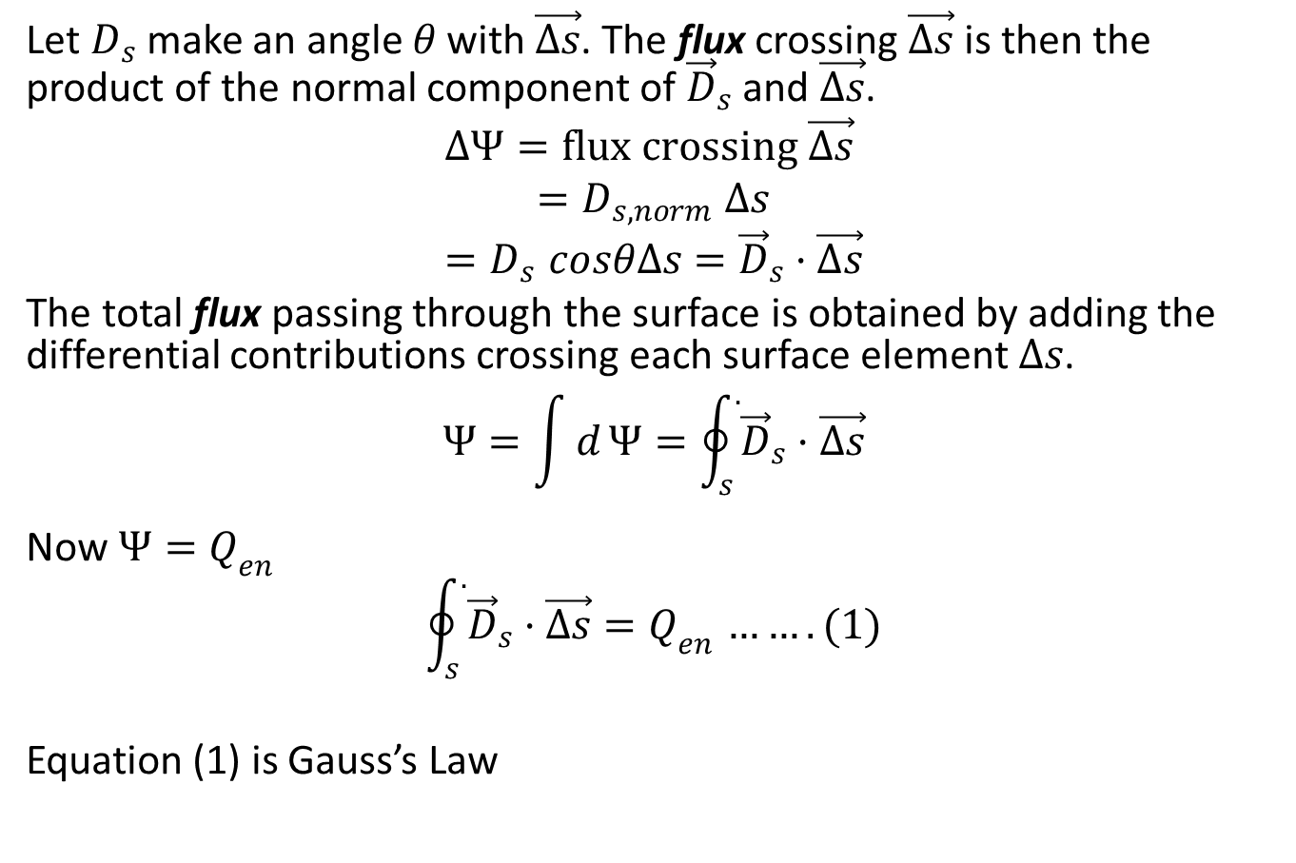
Let $D_{s}$ make an angle $θ$ with $\vec{∆s}$. The flux crossing $\vec{∆s}$ is then the product of the normal component of ${\vec{D}}_{s}$ and $\vec{∆s}$.
$$∆Ψ=flux crossing \vec{∆s}$$
$${=D}_{s,norm}∆s$$
$${=D}_{s}cosθ∆s={\vec{D}}_{s}·\vec{∆s}$$
The total flux passing through the surface is obtained by adding the differential contributions crossing each surface element $∆s$.
$$Ψ=\int{d}Ψ=\oint_{s}^{.}{{\vec{D}}_{s}·\vec{∆s}}$$
Now $Ψ{=Q}_{en}$
$$\oint_{s}^{.}{{\vec{D}}_{s}·\vec{∆s}}{=Q}_{en}…….(1)$$
Equation (1) is Gauss’s Law

Slide 7
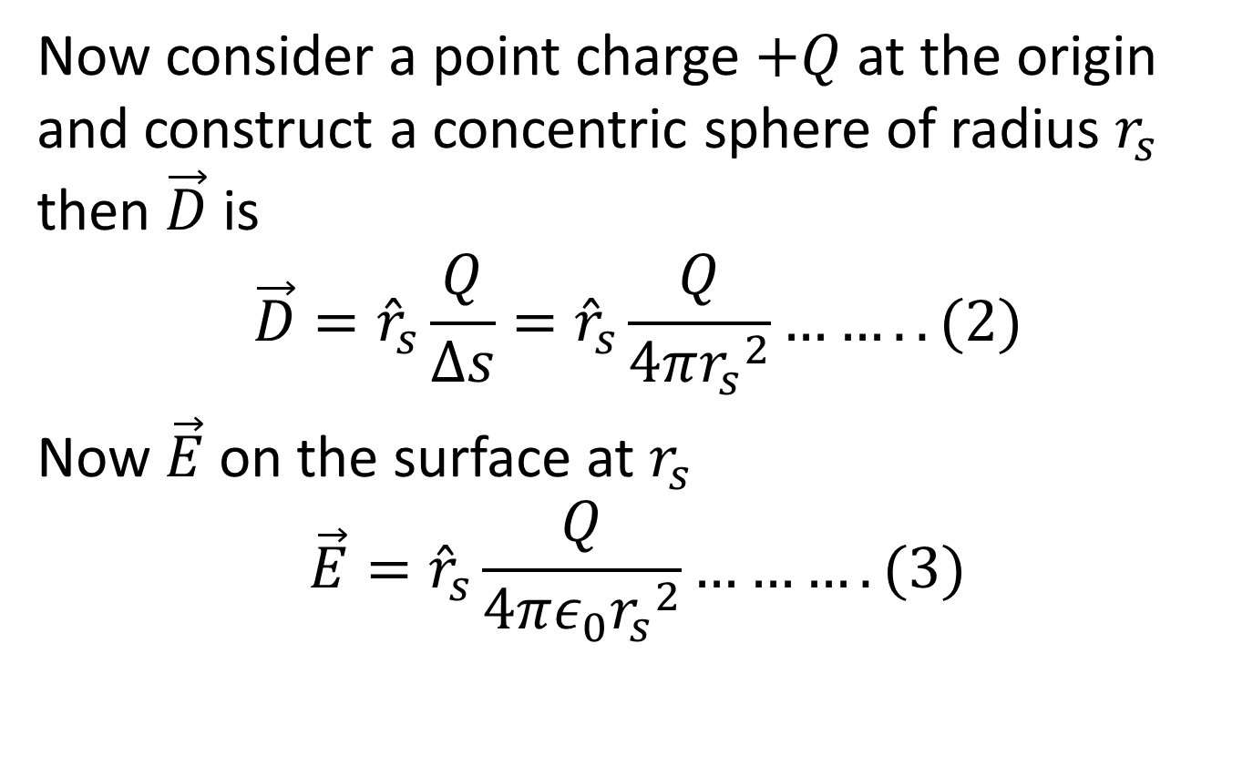
Now consider a point charge $+Q$ at the origin and construct a concentric sphere of radius $r_{s}$ then $\vec{D}$ is
$$\vec{D}={\hat{r}}_{s}\frac{Q}{∆s}={\hat{r}}_{s}\frac{Q}{4π{r_{s}}^{2}}……..(2)$$
Now $\vec{E}$ on the surface at $r_{s}$
$$\vec{E}={\hat{r}}_{s}\frac{Q}{4πε_{0}{r_{s}}^{2}}……….(3)$$

Slide 8
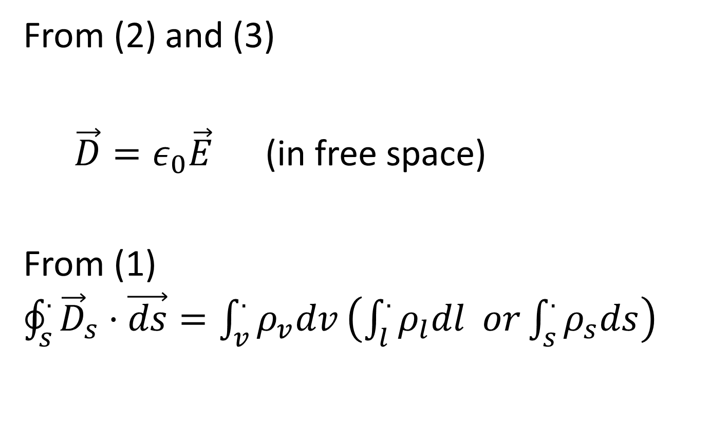
From (2) and (3)
$\vec{D}=ε_{0}\vec{E}$ (in free space)
From (1) $\oint_{s}^{.}{{\vec{D}}_{s}·\vec{ds}}=\int_{v}^{.}{ρ_{v}dv}\left(\int_{l}^{.}{ρ_{l}dl} or\int_{s}^{.}{ρ_{s}ds}\right)$

Slide 9
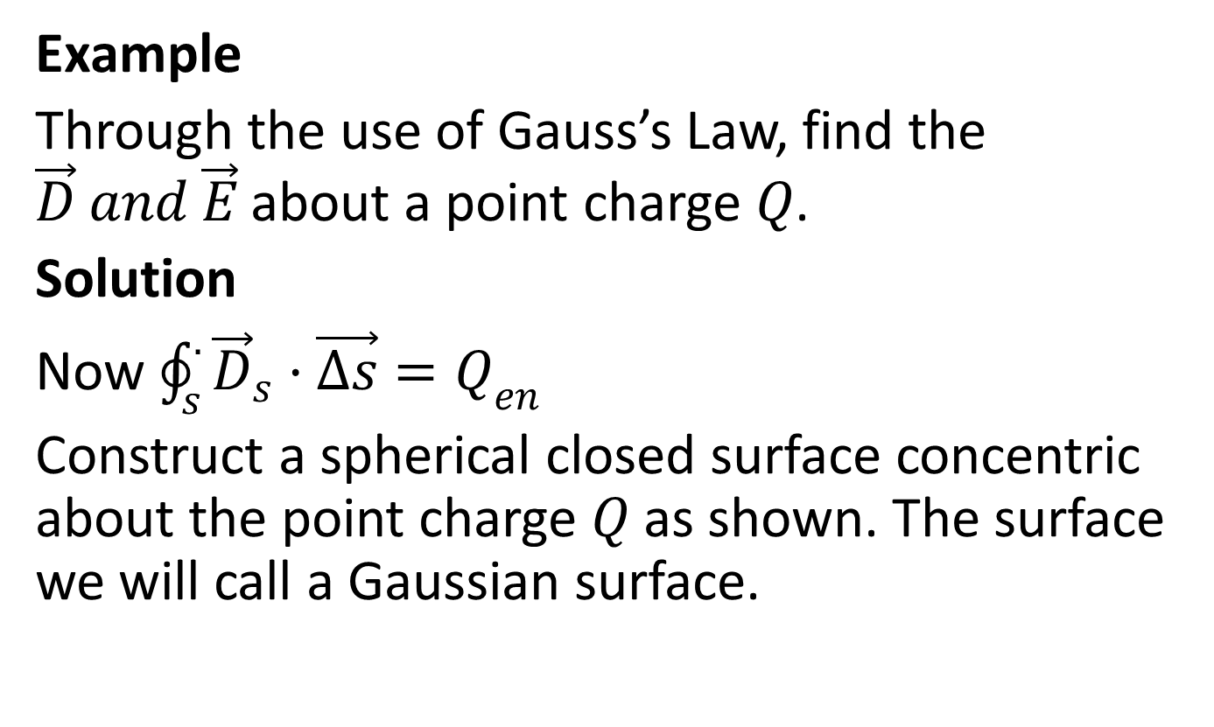
Example
Through the use of Gauss’s Law, find the $\vec{D} and \vec{E}$ about a point charge $Q$.
Solution
Now $\oint_{s}^{.}{{\vec{D}}_{s}·\vec{∆s}}{=Q}_{en}$
Construct a spherical closed surface concentric about the point charge $Q$ as shown. The surface we will call a Gaussian surface.

Slide 10
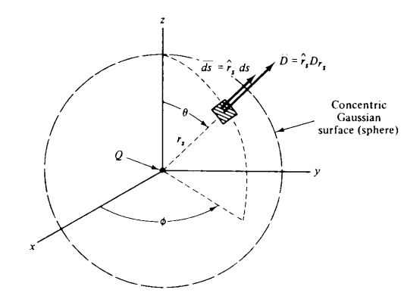

Slide 11
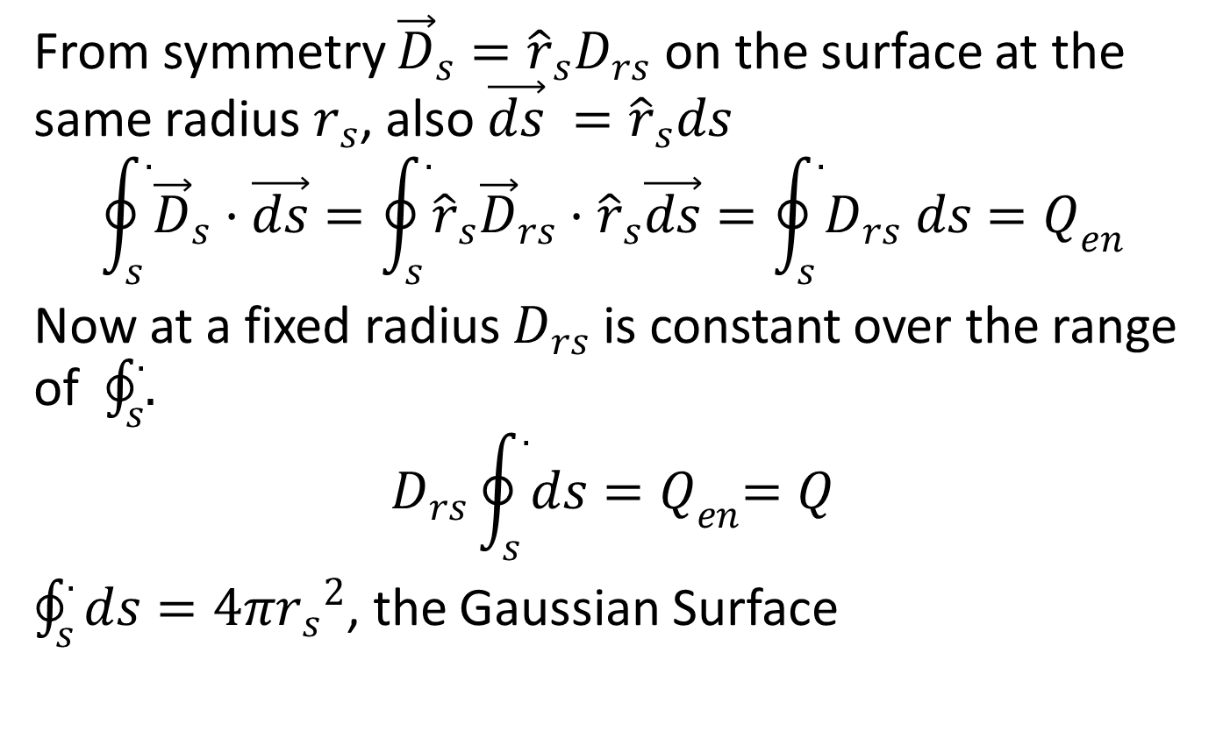
From symmetry ${\vec{D}}_{s}={\hat{r}}_{s}D_{rs}$ on the surface at the same radius $r_{s}$, also $\vec{ds} ={\hat{r}}_{s}ds$
$$\oint_{s}^{.}{{\vec{D}}_{s}·\vec{ds}}=\oint_{s}^{.}{{\hat{r}}_{s}{\vec{D}}_{rs}·{\hat{r}}_{s}\vec{ds}}=\oint_{s}^{.}{D_{rs} ds{=Q}_{en}}$$
Now at a fixed radius $D_{rs}$ is constant over the range of $\oint_{s}^{.}{.}$
$$D_{rs}\oint_{s}^{.}{ds{=Q}_{en}=Q}$$
$\oint_{s}^{.}{ds}=4π{r_{s}}^{2}$, the Gaussian Surface

Slide 12
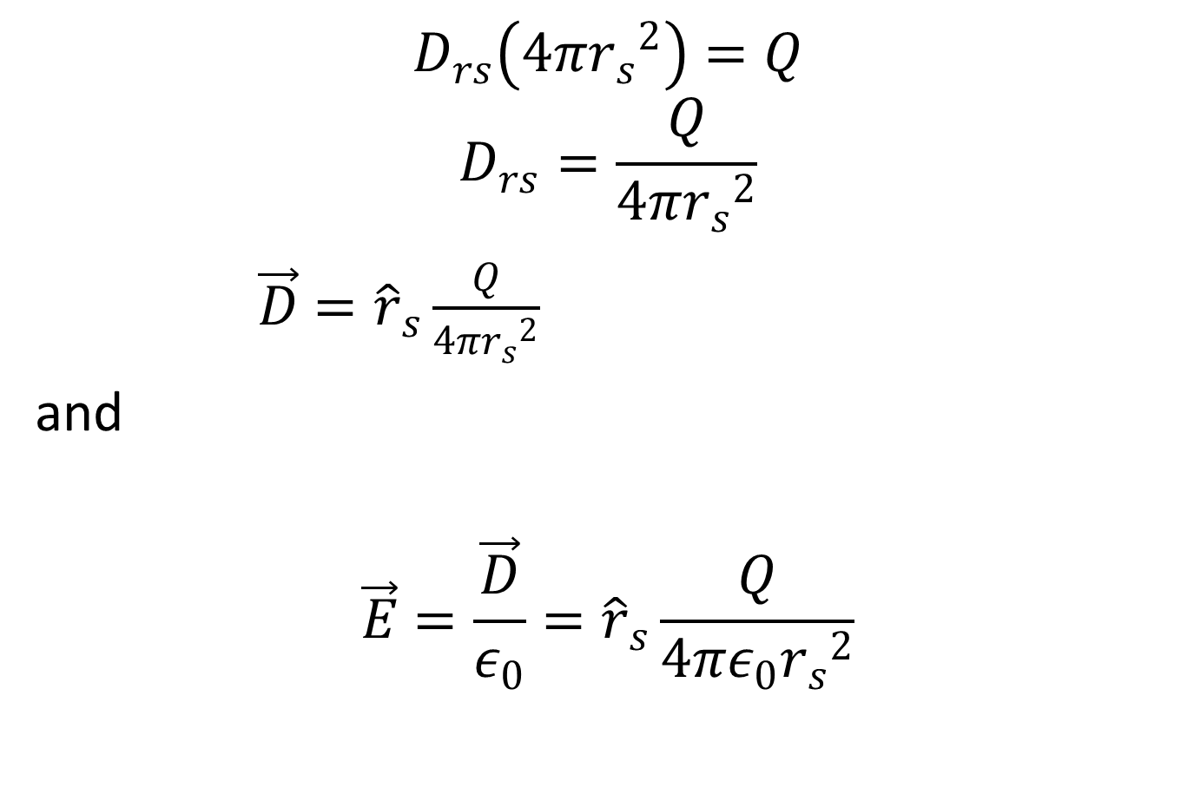
$$D_{rs}\left(4π{r_{s}}^{2}\right)=Q$$
$$D_{rs}=\frac{Q}{4π{r_{s}}^{2}}$$
$\vec{D}={\hat{r}}_{s}\frac{Q}{4π{r_{s}}^{2}}$
and
$$\vec{E}=\frac{\vec{D}}{ε_{0}}={\hat{r}}_{s}\frac{Q}{4π{ε_{0}r_{s}}^{2}}$$

Slide 13
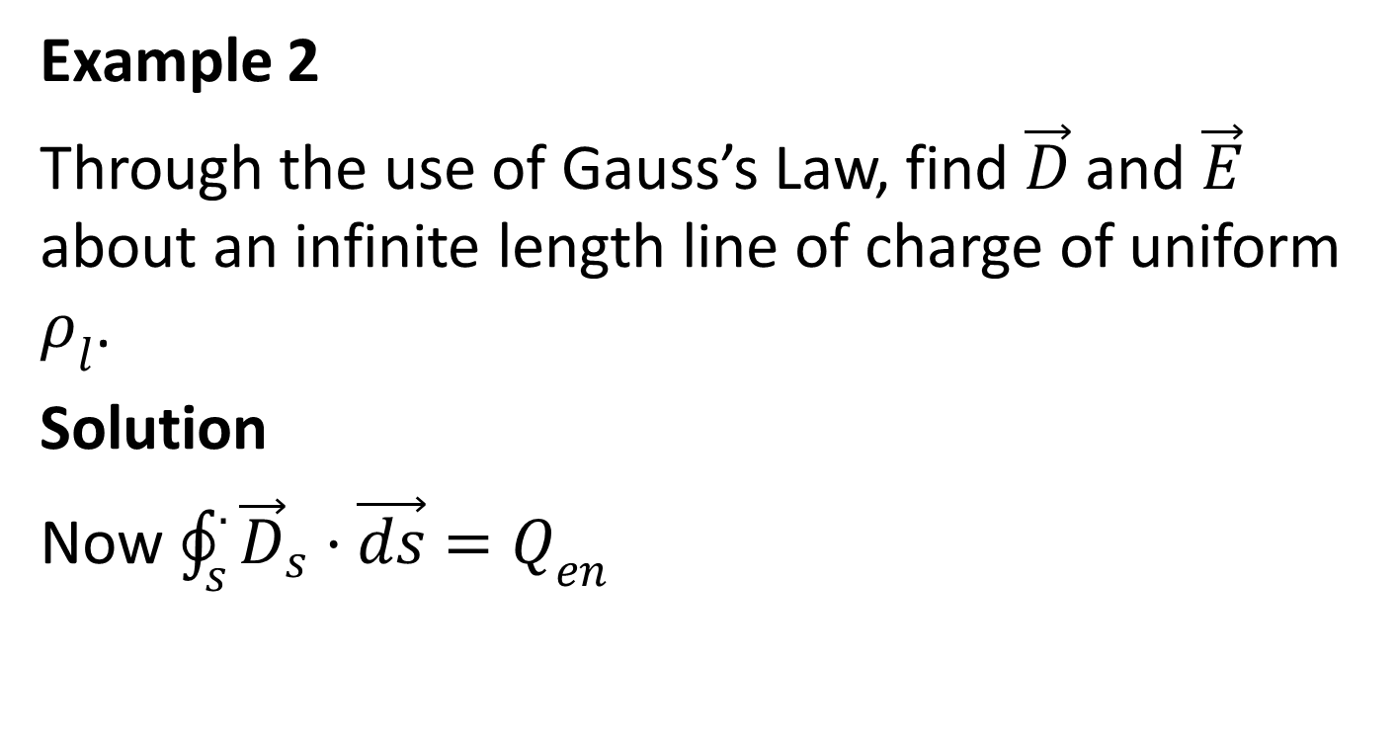
Example 2
Through the use of Gauss’s Law, find $\vec{D}$ and $\vec{E}$ about an infinite length line of charge of uniform $ρ_{l}$.
Solution
Now $\oint_{s}^{.}{{\vec{D}}_{s}·\vec{ds}}{=Q}_{en}$

Slide 14
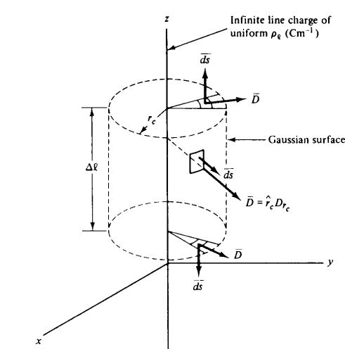

Slide 15
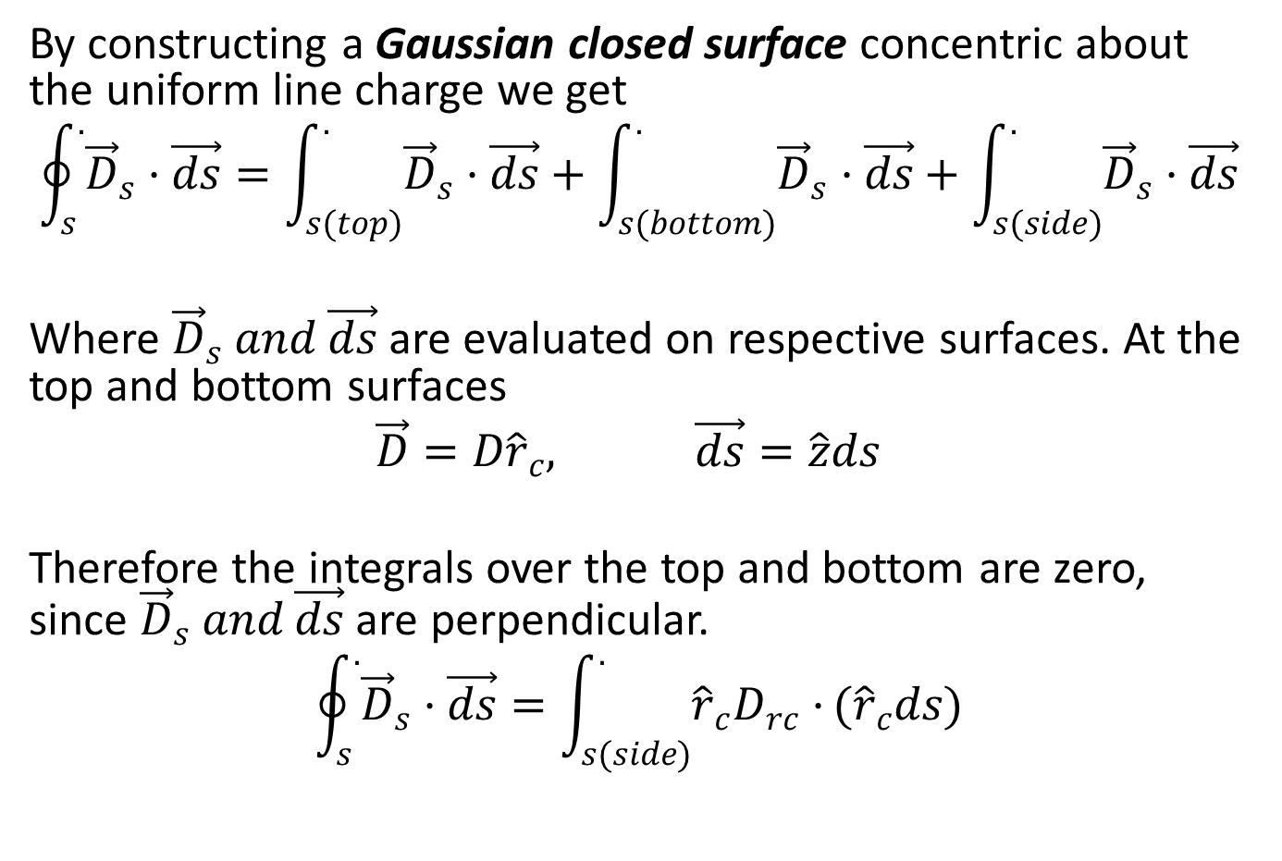
By constructing a Gaussian closed surface concentric about the uniform line charge we get
$$\oint_{s}^{.}{{\vec{D}}_{s}·\vec{ds}}=\int_{s(top)}^{.}{{\vec{D}}_{s}·\vec{ds}}+\int_{s(bottom)}^{.}{{\vec{D}}_{s}·\vec{ds}}+\int_{s(side)}^{.}{{\vec{D}}_{s}·\vec{ds}}$$
Where ${\vec{D}}_{s} and \vec{ds}$ are evaluated on respective surfaces. At the top and bottom surfaces
$$\vec{D}=D{\hat{r}}_{c}, \vec{ds}=\hat{z}ds$$
Therefore the integrals over the top and bottom are zero, since ${\vec{D}}_{s} and \vec{ds}$ are perpendicular.
$$\oint_{s}^{.}{{\vec{D}}_{s}·\vec{ds}}=\int_{s(side)}^{.}{{\hat{r}}_{c}D_{rc}·}({\hat{r}}_{c}ds)$$

Slide 16
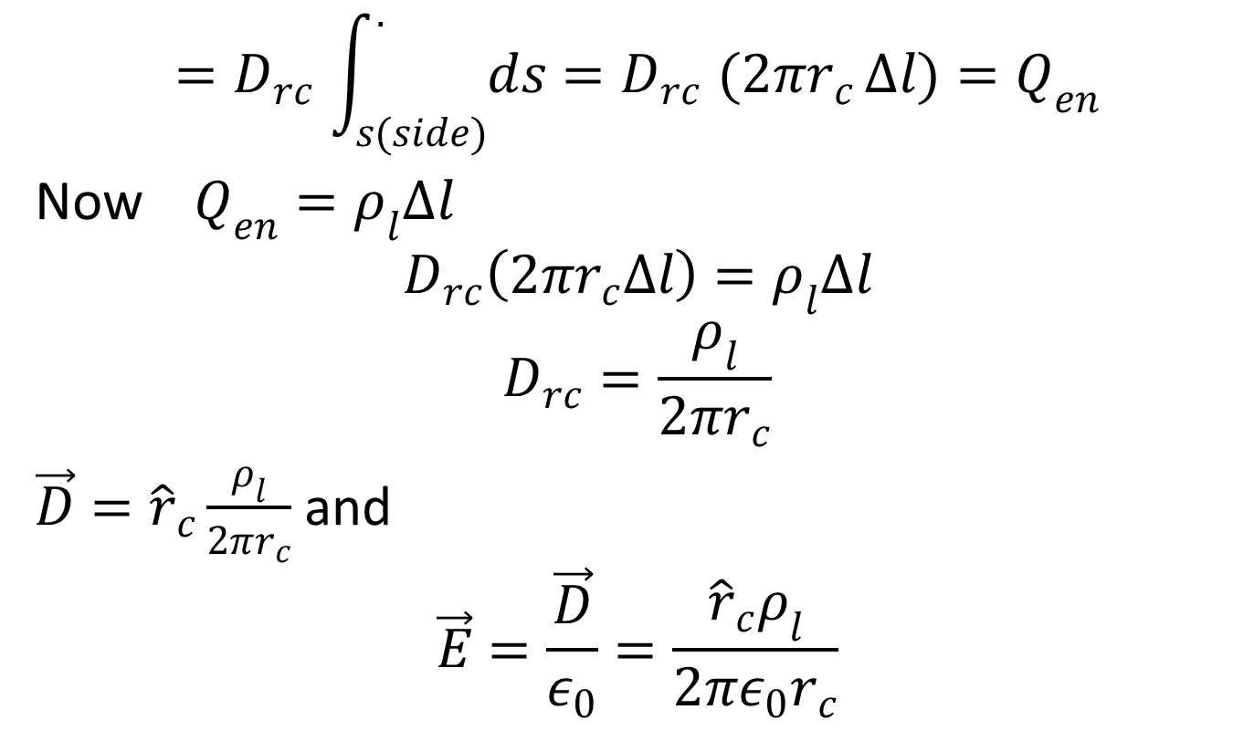
$${=D}_{rc}\int_{s(side)}^{.}{ds{=D}_{rc}(2πr_{c}}∆l){=Q}_{en}$$
Now $Q_{en}=ρ_{l}∆l$
$$D_{rc}\left(2πr_{c}∆l\right)=ρ_{l}∆l$$
$$D_{rc}=\frac{ρ_{l}}{2πr_{c}}$$
$\vec{D}={\hat{r}}_{c}\frac{ρ_{l}}{2πr_{c}}$ and
$$\vec{E}=\frac{\vec{D}}{ε_{0}}=\frac{{\hat{r}}_{c}ρ_{l}}{2πε_{0}r_{c}}$$

Slide 17
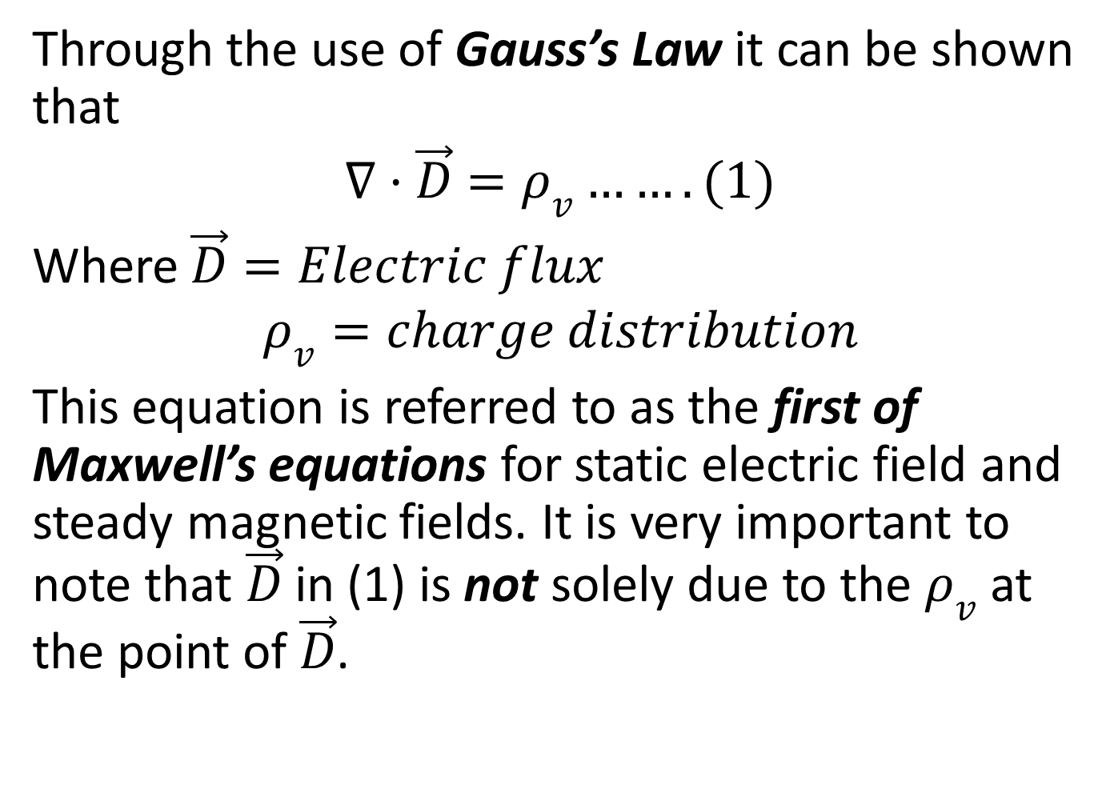
DIVERGENCE AND DIVERGENCE THEOREM
Through the use of Gauss’s Law it can be shown that
$$∇·\vec{D}=ρ_{v}…….(1)$$
Where $\vec{D}=Electric flux$
$$ρ_{v}=charge distribution$$
This equation is referred to as the first of Maxwell’s equations for static electric field and steady magnetic fields. It is very important to note that $\vec{D}$ in (1) is not solely due to the $ρ_{v}$ at the point of $\vec{D}$.

Slide 18

Now $\vec{D}=ε_{0}\vec{E}$
$$∇·\vec{D}=∇·ε_{0}\vec{E}=ρ_{v}$$
$$∇·\vec{E}=\frac{ρ_{v}}{ε_{0}} \left(vm^{−2}\right)…….(2)$$

Slide 19
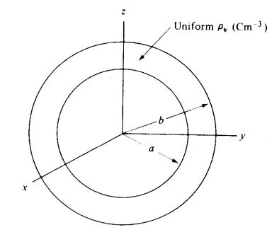

Example
For a thick spherical shell of uniform $ρ_{v}$ distribution, as shown in the figure below, the $\vec{D}$ expression are

Slide 20
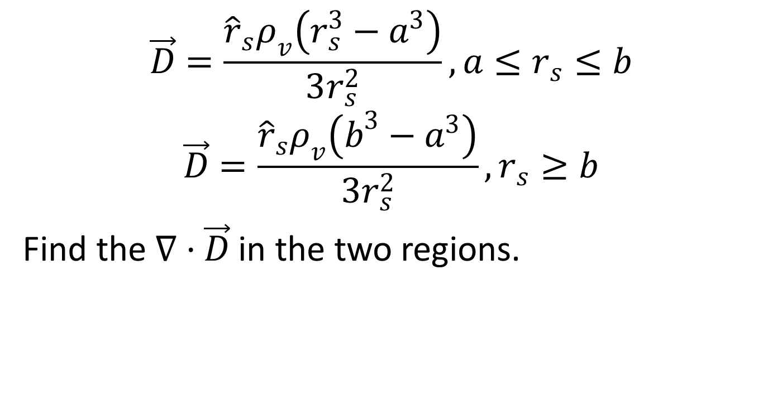
$$\vec{D}=\frac{{\hat{r}}_{s}ρ_{v}\left(r_{s}^{3}−a^{3}\right)}{3r_{s}^{2}}, a≤r_{s}≤b$$
$$\vec{D}=\frac{{\hat{r}}_{s}ρ_{v}\left(b^{3}−a^{3}\right)}{3r_{s}^{2}}, r_{s}≥b$$
Find the $∇·\vec{D}$ in the two regions.

Slide 21
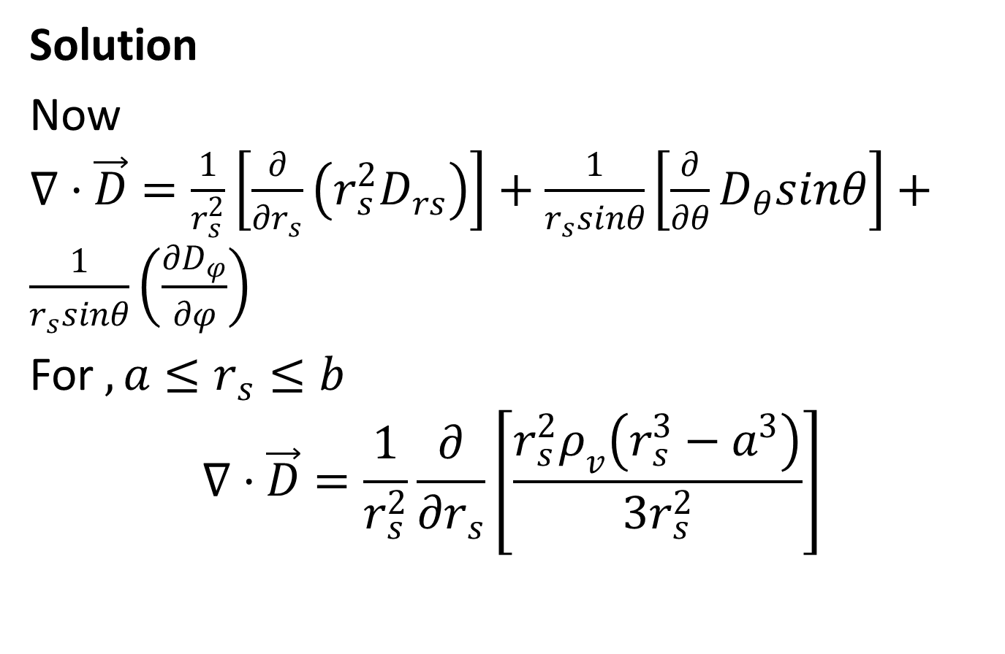
Solution
Now $∇·\vec{D}=\frac{1}{r_{s}^{2}}\left[\frac{∂}{∂r_{s}}\left(r_{s}^{2}D_{rs}\right)\right]+\frac{1}{r_{s}sinθ}\left[\frac{∂}{∂θ}D_{θ}sinθ\right]+\frac{1}{r_{s}sinθ}\left(\frac{∂D_{φ}}{∂φ}\right)$
For $, a≤r_{s}≤b$
$$∇·\vec{D}=\frac{1}{r_{s}^{2}}\frac{∂}{∂r_{s}}\left[\frac{{r_{s}^{2}ρ}_{v}\left(r_{s}^{3}−a^{3}\right)}{3r_{s}^{2}}\right]$$

Slide 22
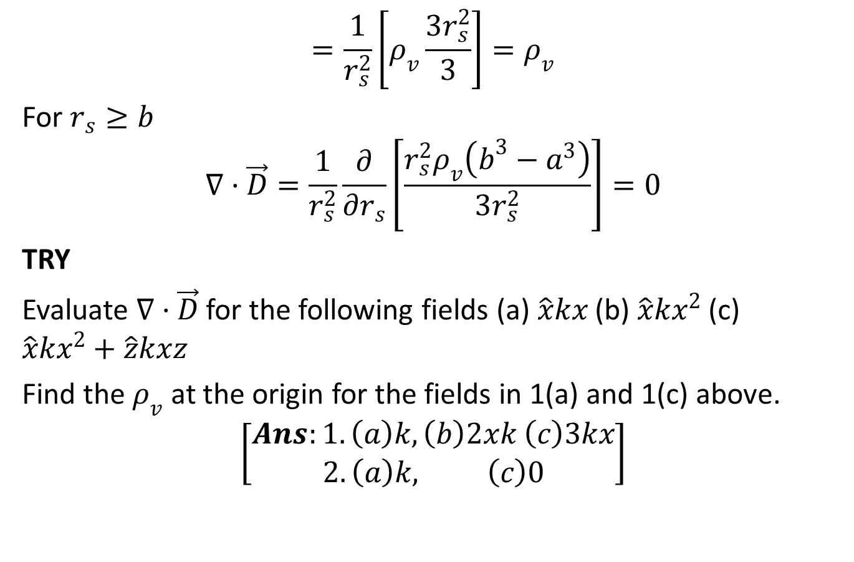
$$=\frac{1}{r_{s}^{2}}\left[ρ_{v}\frac{3r_{s}^{2}}{3}\right]=ρ_{v}$$
For $r_{s}≥b$
$$∇·\vec{D}=\frac{1}{r_{s}^{2}}\frac{∂}{∂r_{s}}\left[\frac{{r_{s}^{2}ρ}_{v}\left(b^{3}−a^{3}\right)}{3r_{s}^{2}}\right]=0$$
TRY
Evaluate $∇·\vec{D}$ for the following fields (a) $\hat{x}kx$ (b) $\hat{x}kx^{2}$ (c) $\hat{x}kx^{2}+\hat{z}kxz$
Find the $ρ_{v}$ at the origin for the fields in 1(a) and 1(c) above.
$$\left[\begin{aligned}Ans:1. \left(a\right)k, \left(b\right)2xk \left(c\right)3kx \\ 2. \left(a\right)k, \left(c\right)0\end{aligned}\right]$$

Slide 23
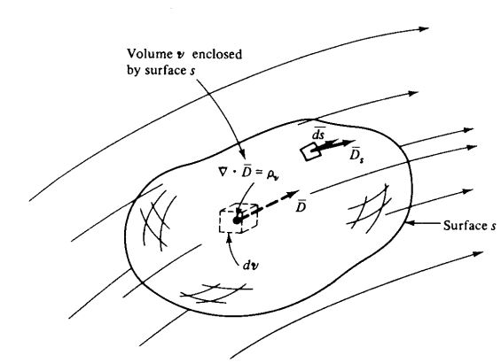
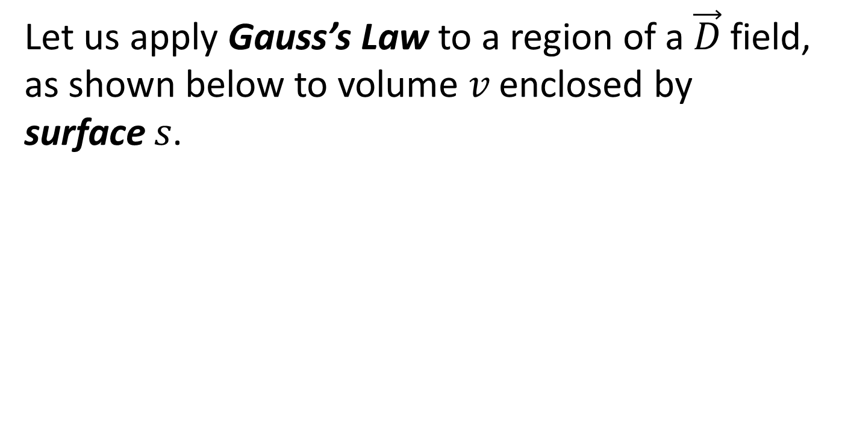
Let us apply Gauss’s Law to a region of a $\vec{D}$ field, as shown below to volume $v$ enclosed by surface $s$.

Slide 24
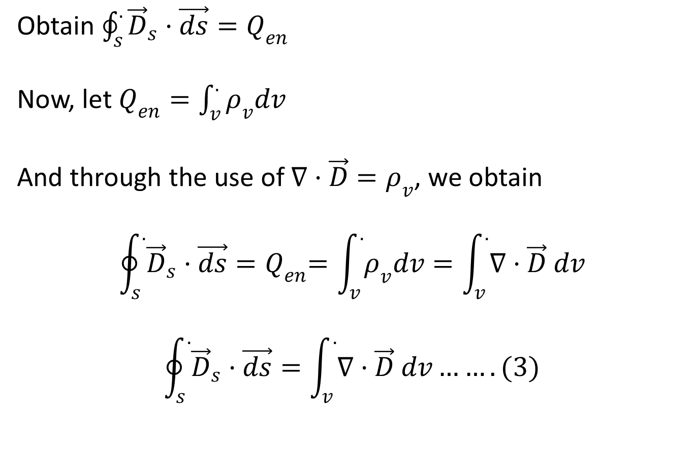
Obtain $\oint_{s}^{.}{{\vec{D}}_{s}·\vec{ds}}{=Q}_{en}$
Now, let $Q_{en}=\int_{v}^{.}{ρ_{v}dv}$
And through the use of $∇·\vec{D}=ρ_{v}$, we obtain
$$\oint_{s}^{.}{{\vec{D}}_{s}·\vec{ds}}{=Q}_{en}=\int_{v}^{.}{ρ_{v}dv}=\int_{v}^{.}{∇·\vec{D} dv}$$
$$\oint_{s}^{.}{{\vec{D}}_{s}·\vec{ds}}=\int_{v}^{.}{∇·\vec{D} dv…….(3)}$$

Slide 25
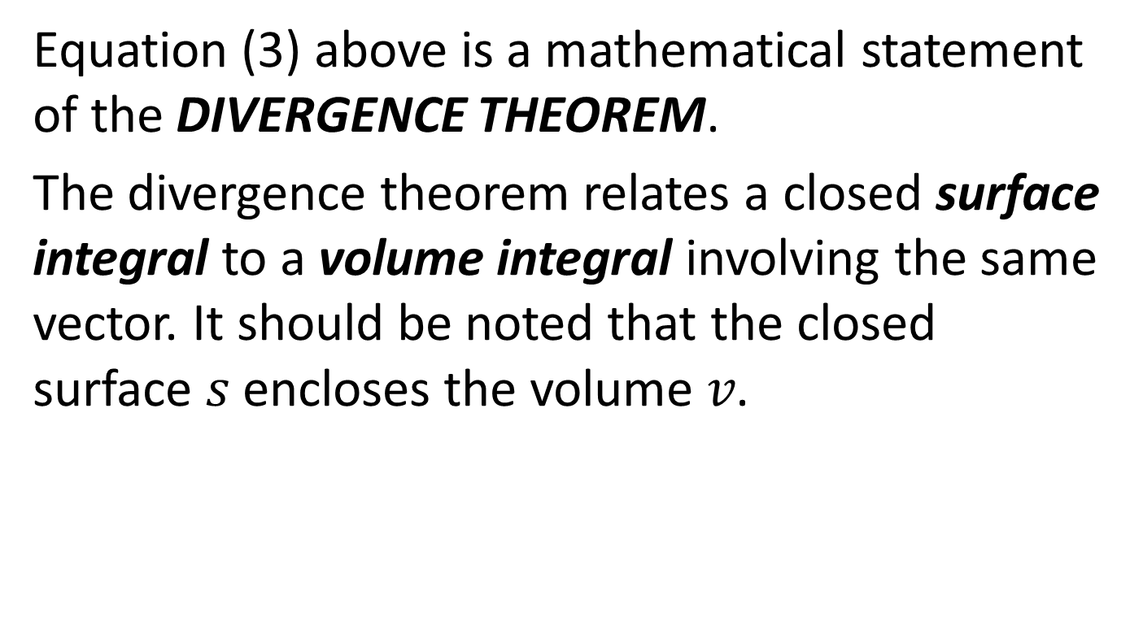
Equation (3) above is a mathematical statement of the DIVERGENCE THEOREM.
The divergence theorem relates a closed surface integral to a volume integral involving the same vector. It should be noted that the closed surface $s$ encloses the volume $v$.

Slide 26
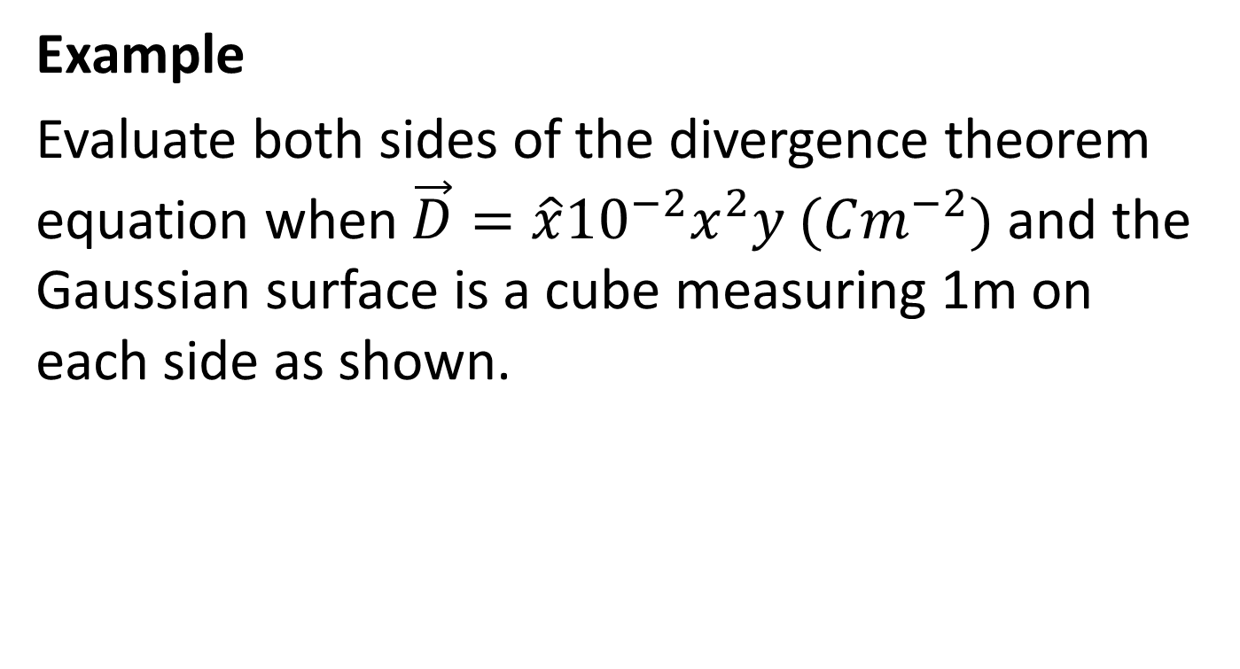
Example
Evaluate both sides of the divergence theorem equation when $\vec{D}=\hat{x}{10}^{−2}x^{2}y (Cm^{−2})$ and the Gaussian surface is a cube measuring 1m on each side as shown.

Slide 27
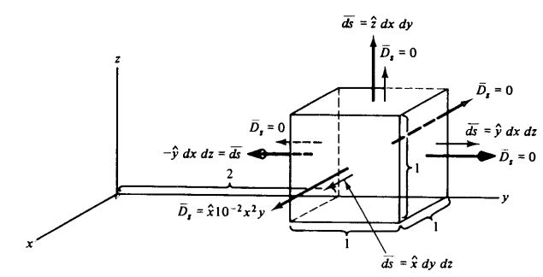

Slide 28
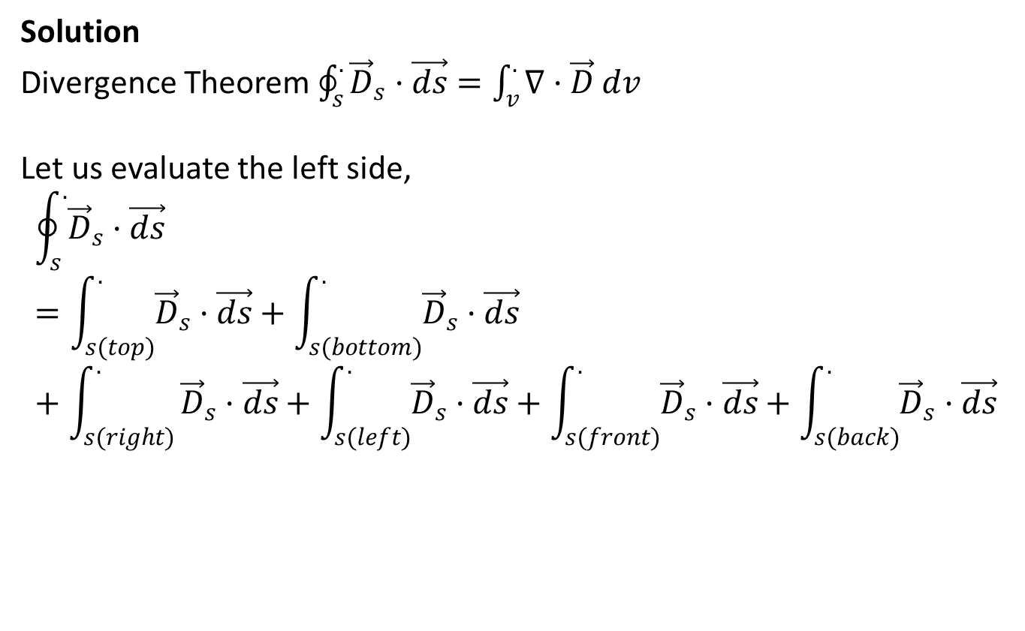
Solution
Divergence Theorem $\oint_{s}^{.}{{\vec{D}}_{s}·\vec{ds}}=\int_{v}^{.}{∇·\vec{D} dv}$
Let us evaluate the left side,
$$\oint_{s}^{.}{{\vec{D}}_{s}·\vec{ds}}=\int_{s(top)}^{.}{{\vec{D}}_{s}·\vec{ds}}+\int_{s(bottom)}^{.}{{\vec{D}}_{s}·\vec{ds}}+\int_{s(right)}^{.}{{\vec{D}}_{s}·\vec{ds}+\int_{s(left)}^{.}{{\vec{D}}_{s}·\vec{ds}}+\int_{s(front)}^{.}{{\vec{D}}_{s}·\vec{ds}}+\int_{s(back)}^{.}{{\vec{D}}_{s}·\vec{ds}}}$$

Slide 29
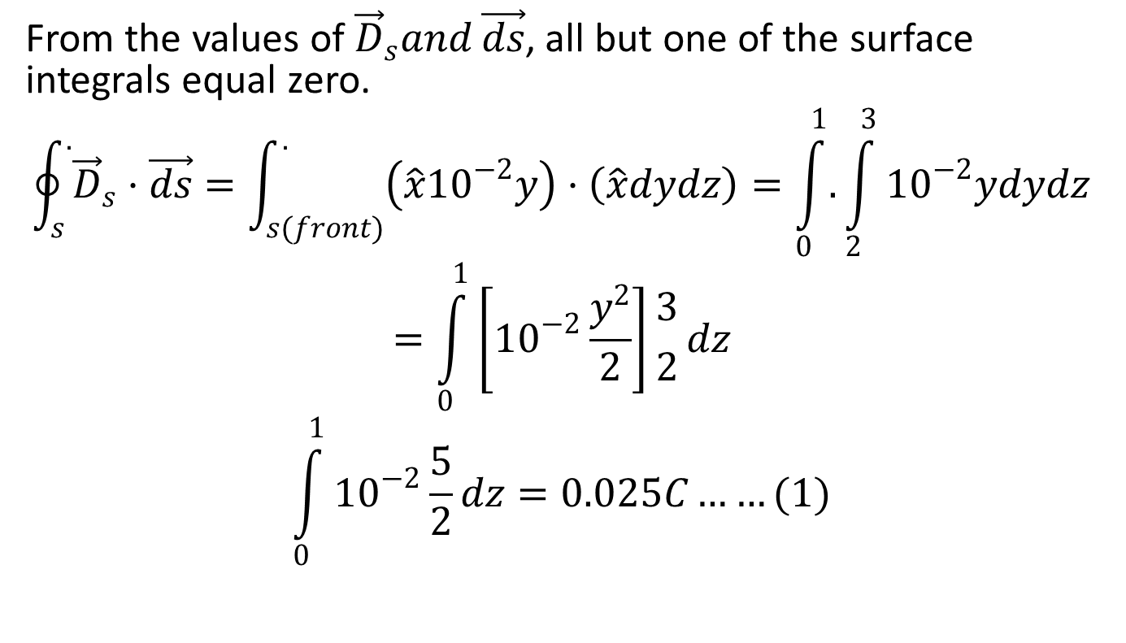
From the values of ${\vec{D}}_{s}and \vec{ds}$, all but one of the surface integrals equal zero.
$$\oint_{s}^{.}{{\vec{D}}_{s}·\vec{ds}}=\int_{s(front)}^{.}{\left(\hat{x}{10}^{−2}y\right)·\left(\hat{x}dydz\right)=\int_{0}^{1}{.}\int_{2}^{3}{{10}^{−2}ydydz}}$$
$$=\int_{0}^{1}{\left[{10}^{−2}\frac{y^{2}}{2}\right]}{3 \atop 2}dz$$
$$\int_{0}^{1}{{10}^{−2}\frac{5}{2}}dz=0.025C……(1)$$

Slide 30
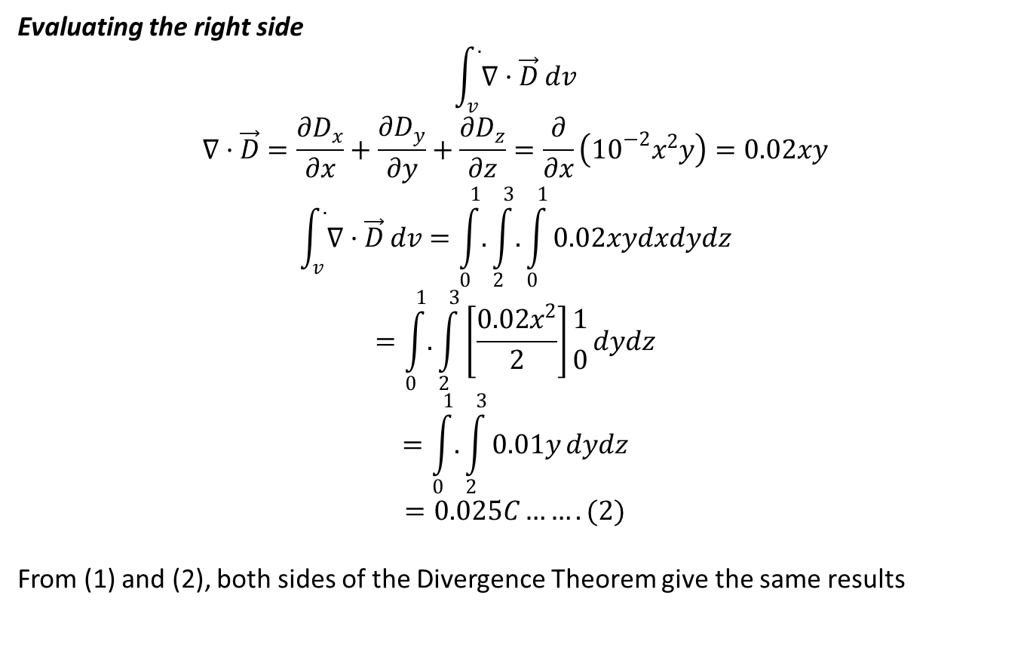
Evaluating the right side
$$\int_{v}^{.}{∇·\vec{D} dv}$$
$$∇·\vec{D}=\frac{∂D_{x}}{∂x}+\frac{∂D_{y}}{∂y}+\frac{∂D_{z}}{∂z}=\frac{∂}{∂x}\left({10}^{−2}x^{2}y\right)=0.02xy$$
$$\int_{v}^{.}{∇·\vec{D} dv}=\int_{0}^{1}{.}\int_{2}^{3}{.}\int_{0}^{1}{0.02xydxdydz}$$
$$=\int_{0}^{1}{.}\int_{2}^{3}{\left[\frac{0.02x^{2}}{2}\right]}{1 \atop 0}dydz$$
$$=\int_{0}^{1}{.}\int_{2}^{3}{0.01y}dydz$$
$$=0.025C…….(2)$$
From (1) and (2), both sides of the Divergence Theorem give the same results

